Slide 1
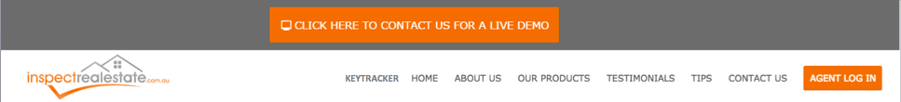

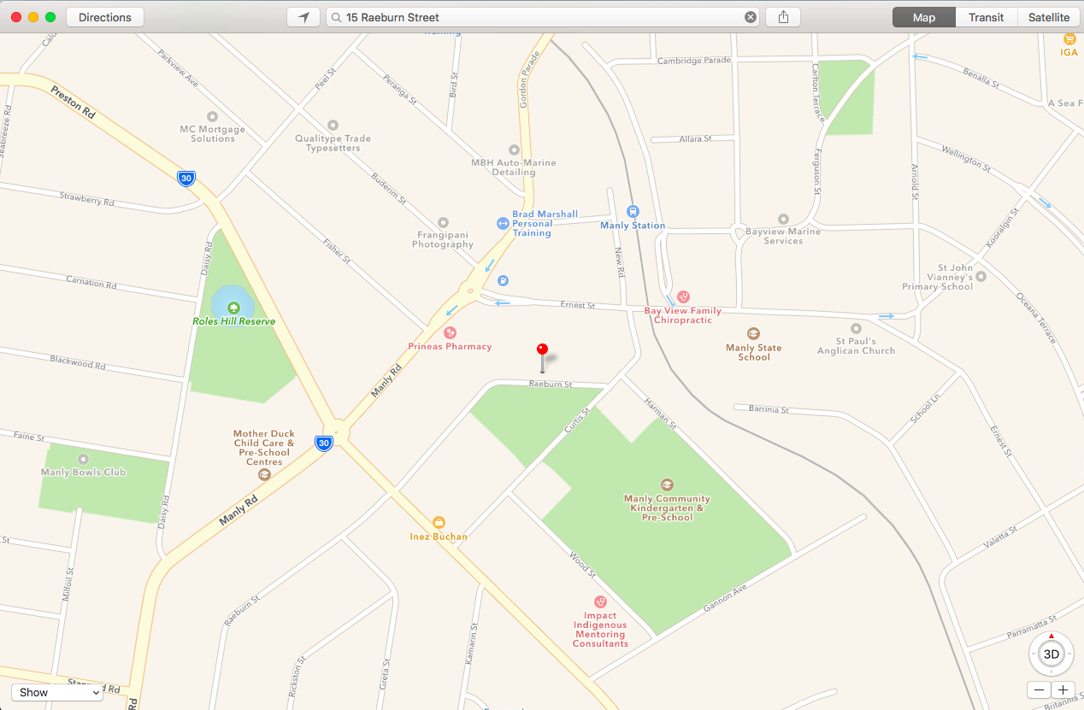
Delivery Schedule
:
Completed Orders
:
Order information
Customer information
Driver Hub
:
Roster Information
Work Email
Individual KPI Statistics
CONTINUE

